Slide 1
Correlations at the margins cannot be rescued by estimation
Greg Gloor
Dep’t of Biochemistry
U. Western Ontario
ggloor@uwo.ca @gbgloor

Slide 2
Count data are sausage
Microbiome
transcriptome
Metagenome
Discrete random sample of the library which is a random sample of the environment

Slide 3
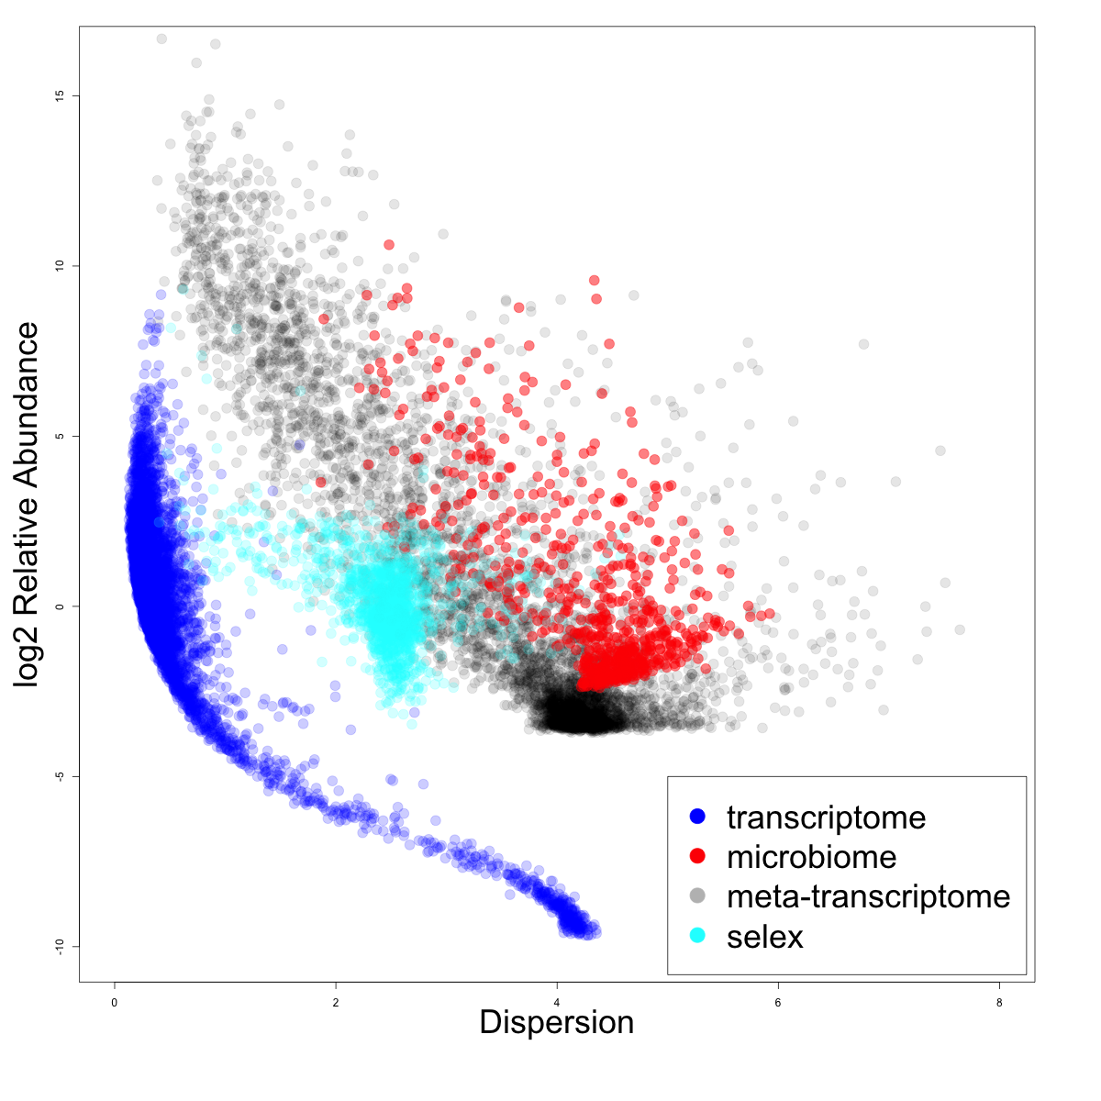
Count data are awful
Sparse
Variable
Discrete
Unpredictable

Slide 4
The lattice (Lovell 2020)
Association between two variables
Approximate constant sum
Choosing a representative annulus of non-0, but not high counts for the two features
In a region people believe there is enough data to be real
Annuli closer to 0 have more extreme edge effects and the reverse

Slide 5
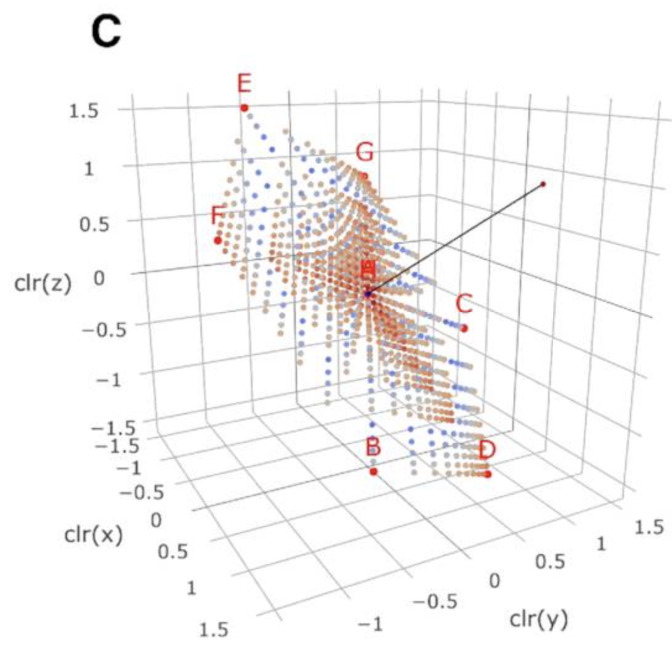

The lattice on the simplex
Lovell used a 3 part lattice
Reduces to discrete points on the simplex
Used a single, constant third value

Slide 6
b-association measures
Var(log(x/y))
Decompose into both slope and correlation of LR transformed data (Erb/Egozcue)
φ = 1 + β₁² – 2β₁ r
Range from 0 to infinity (Lovell)
ρ = 2r/(β₁ + 1/β₁)
Range from -1 to 1 (Erb)

Slide 7
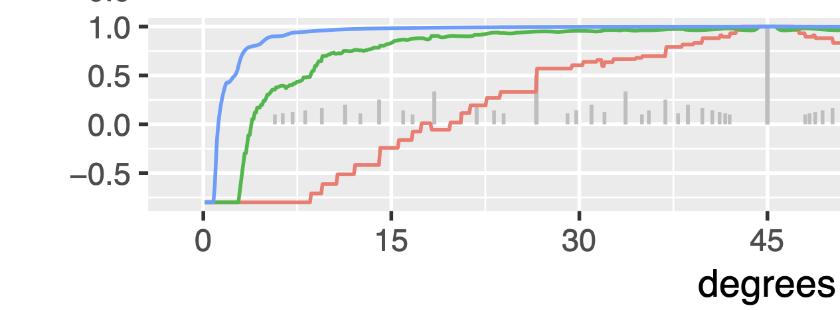

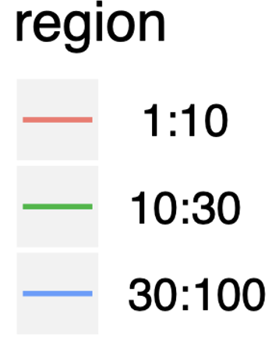
b-association is sensitive to lattice slope
Sweep through lattice from 0 to 45°
Measure ρ correlation and slope
Will focus on 10:30 annulus
Lovell 2020

Slide 8
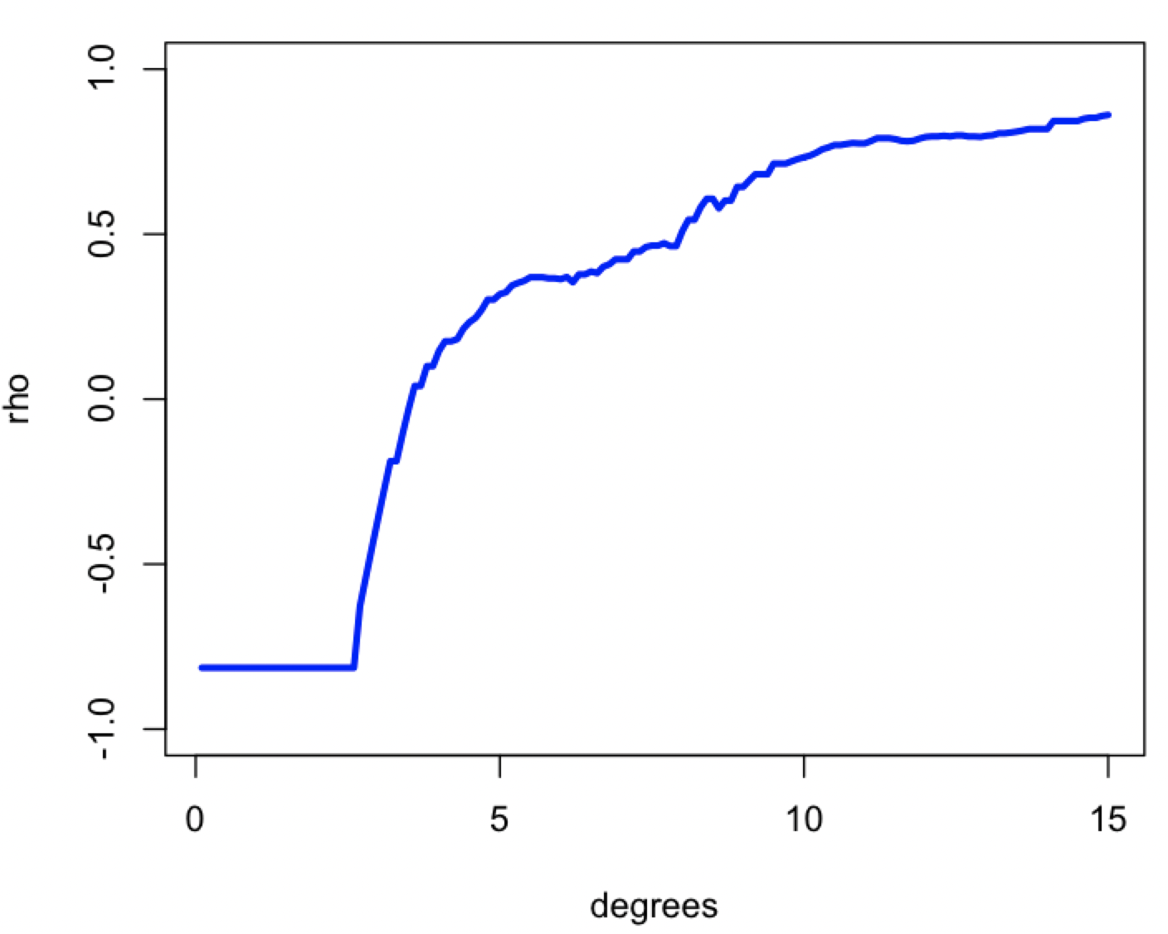
Reproducing the plot
0.1° : 15°
ratio from
~1/20 to
~1/4
Lovell 2020

Slide 9
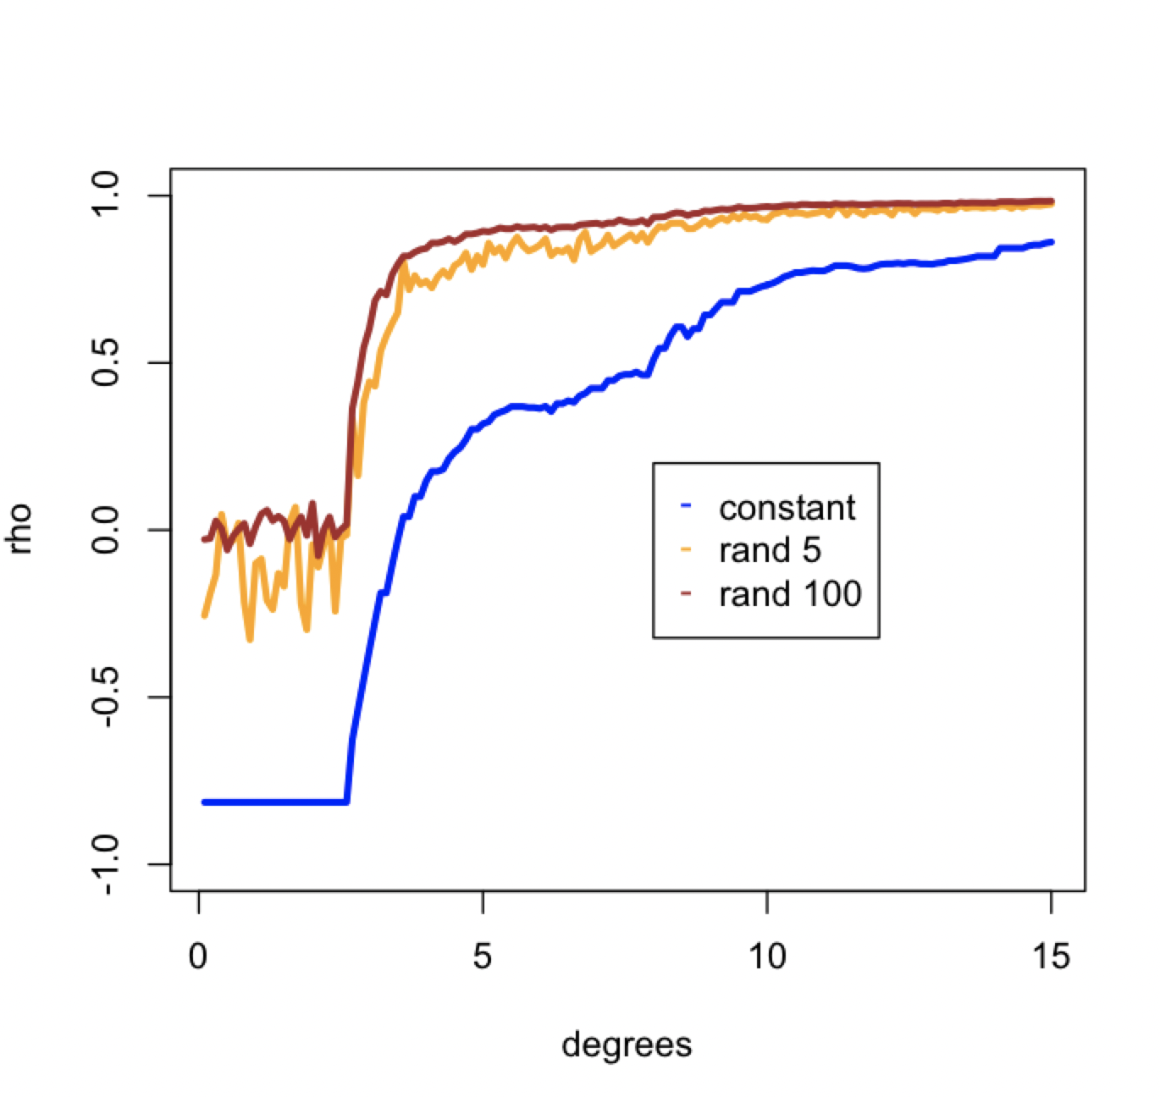
But what about noise?
Adding in stochastic noise
Constrained random data
N = number of random features
More random features are better
runif(100,5,125)
Proportion
Integer scaled to ~2000

Slide 10
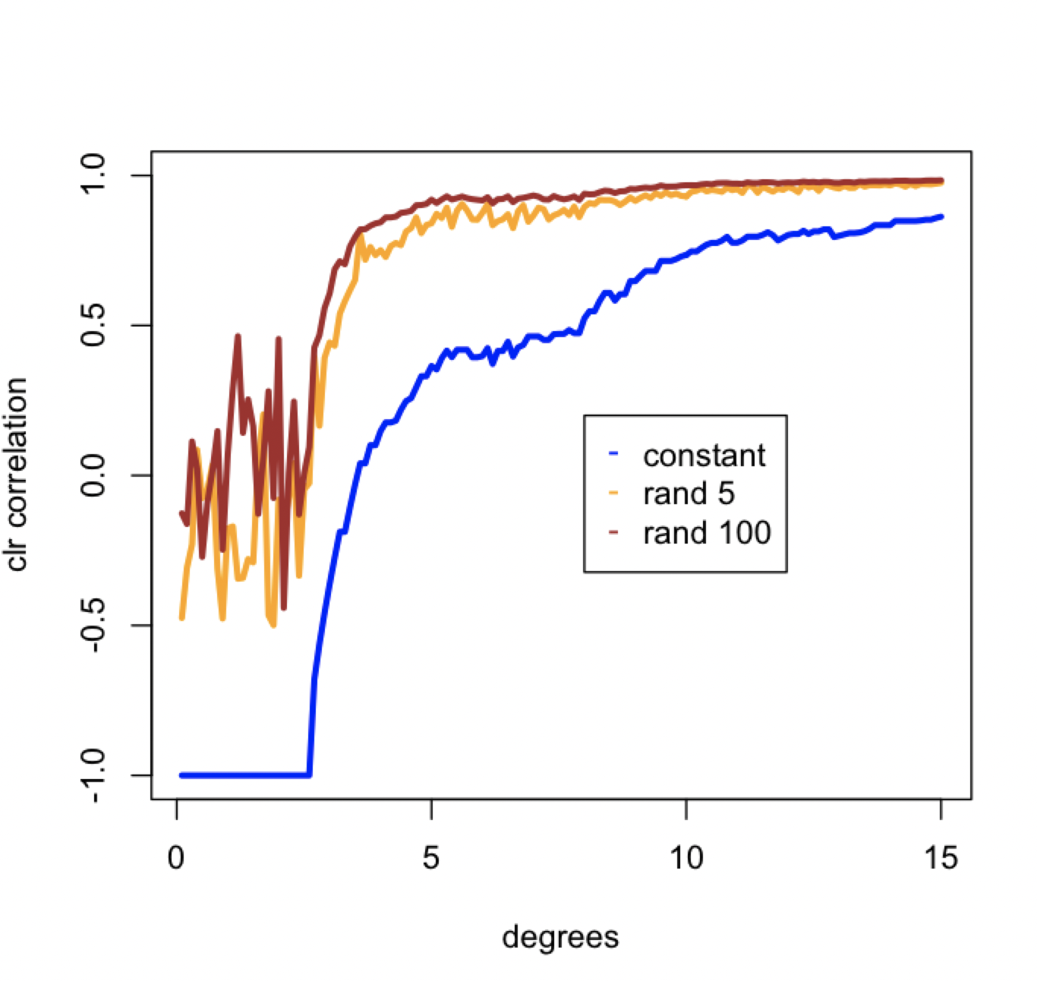
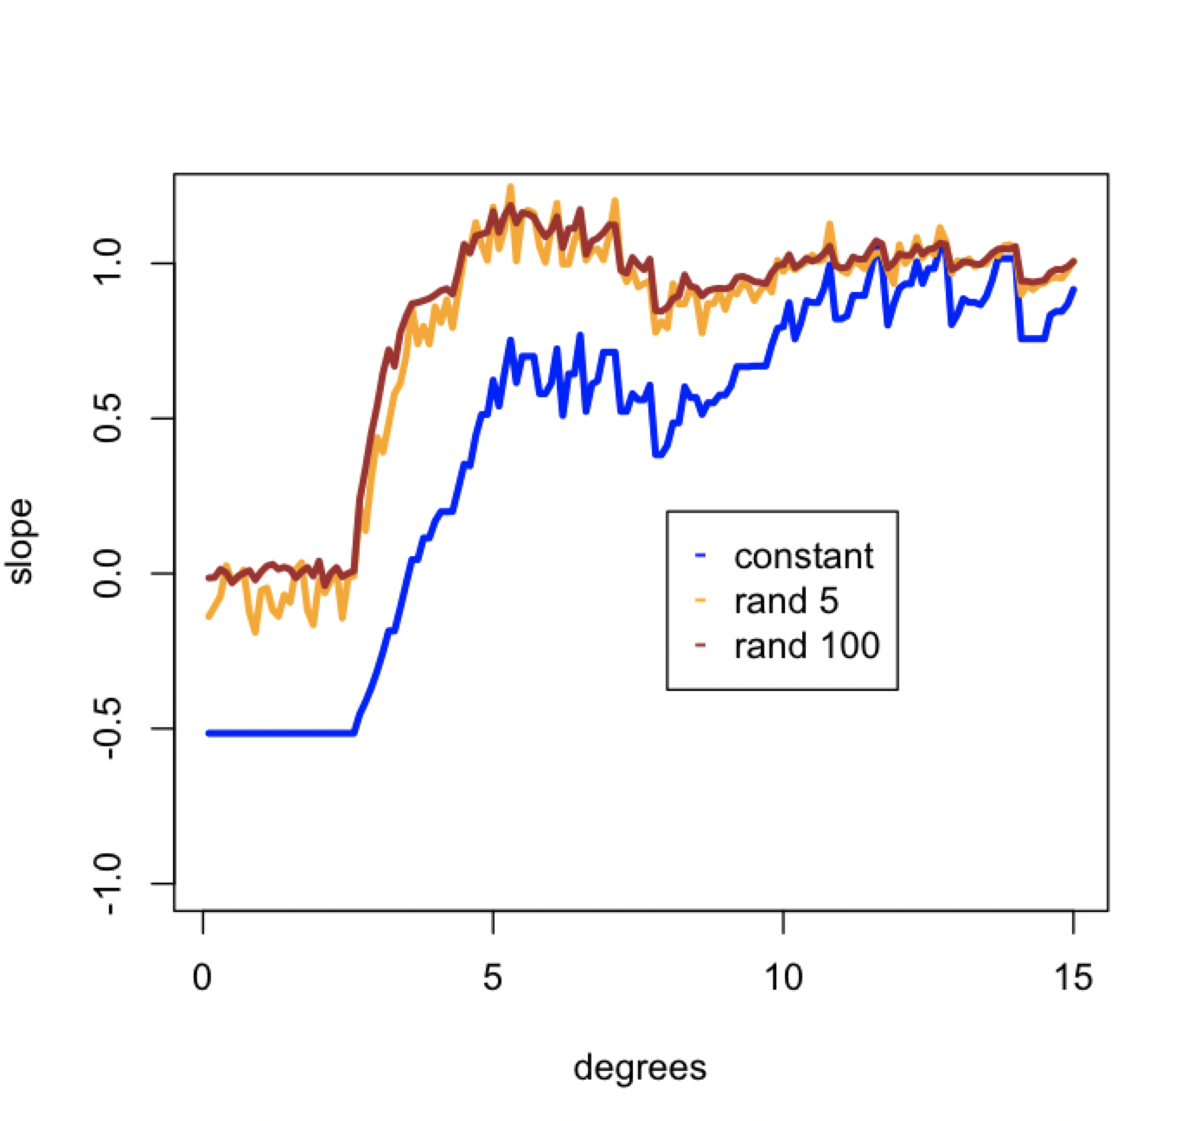
correlation or slope

Slide 11
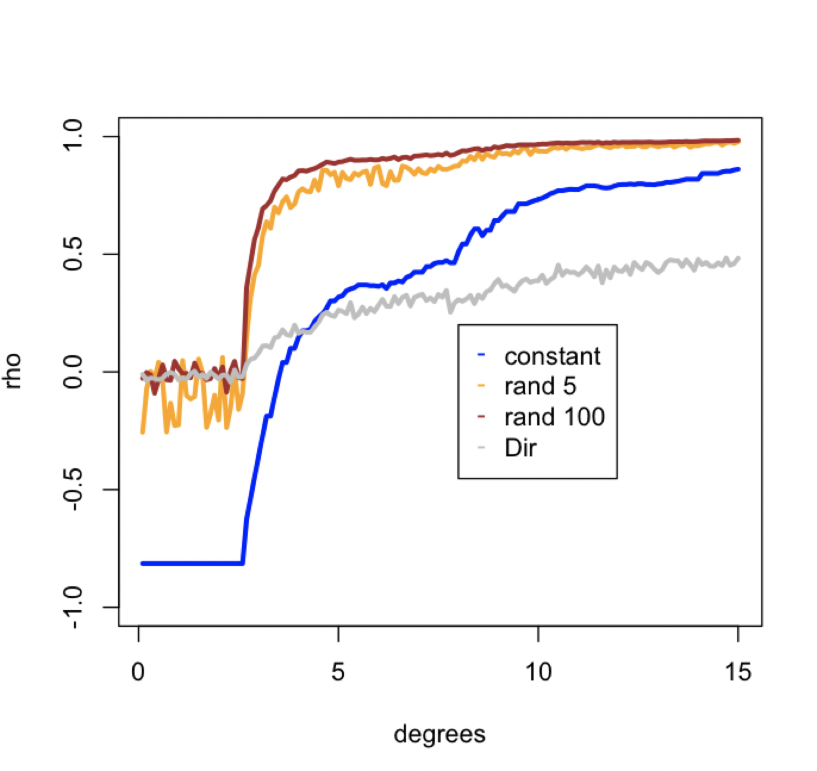
Dirichlet random sampling
Instantiated in ALDEx2
Helpful to reduce FP in DA
An option for propr package
Makes compositional correlation less sensitive
Introduces wide variation at low counts
Negative correlation bias makes this approach inviable

Slide 12
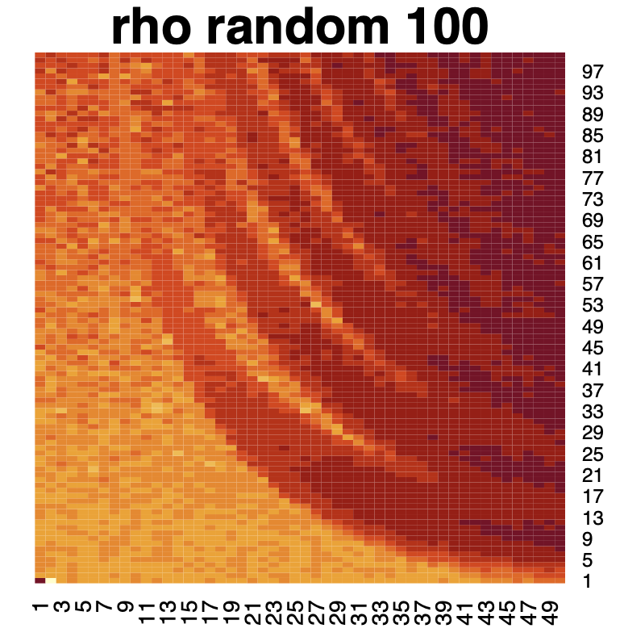
Summary
Counts with random noise are less affected than non-noisy data
Many true associations are invisible
Even high read counts are inaccessible at high ratios
Random sampling of the data by drawing from Dir distribution is not viable
Annulus minimum
Angle (10x)

